Slide 1
MindGames
MIDTERM PROJECT REPORT
4/5/2022
Brandon Knotek (bk11@hood.edu) Walid Muhammad (wm5@hood.edu) Jack Wilder (jmw38@hood.edu)
Notes:
Table of Contents: Project Goal (locked in syndrome), background on EEG, our plan, overview (pipeline, backend, frontend), pipeline overview (data acquisition, preprocessing, classification, output), lessons learned from other groups (better hardware), how we worked together, what is next (end to demo)

Slide 2
Our Goal
Use brain waves to directly control computer software, bypassing the need for a mouse and keyboard.

Slide 3
Why Bother?
Certain disabilities and illnesses make physical interaction difficult or impossible
Some, such as Locked In Syndrome, make all communication impossible
Direct interaction via brain waves can allow for interaction and communication despite these limitations

Slide 4
Unraveling the Brain
All brain activity is electrical
Electroencephalography (EEG) is a non-invasive technique for measuring this activity
Different mental states, thoughts, and actions generate unique electrical patterns

Slide 5
Mind Control - Not Just Sci-Fi
Every brain is different, so patterns can’t be hard-coded into software
Machine learning algorithms can be trained to recognize an individual brain’s patterns
During training, patterns are associated with input commands
These commands are executed in the target software; mind control achieved!

Slide 6
It Can’t Be That Easy…
…It’s not
This technology is actively being researched by groups all around the world
No agreed-upon best practices; just as much of an art as it is a science

Slide 7
Our Plan
Build an application that accepts simple discrete commands (Pac-Man)
Develop a pipeline for processing raw EEG data and classifying it into commands
Transmit commands to Pac-Man and execute them

Slide 8
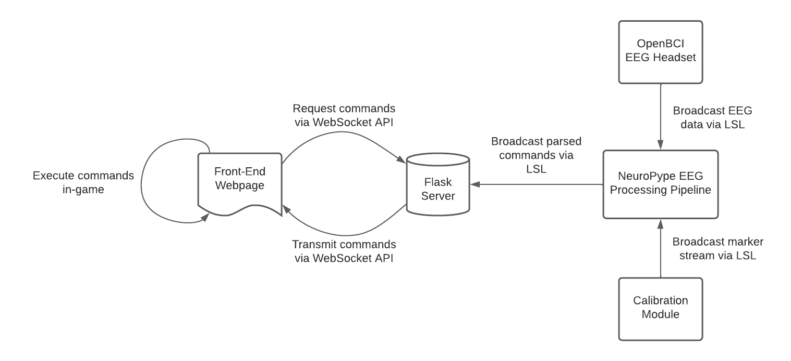
System Overview

Slide 9
Communication Protocols
Bluetooth
EEG data (external)
LSL (Lab Streaming Layer)
EEG data (internal)
Marker stream
WebSocket
Parsed commands
Notes:
LSL built specifically for experimental results are live

Slide 10
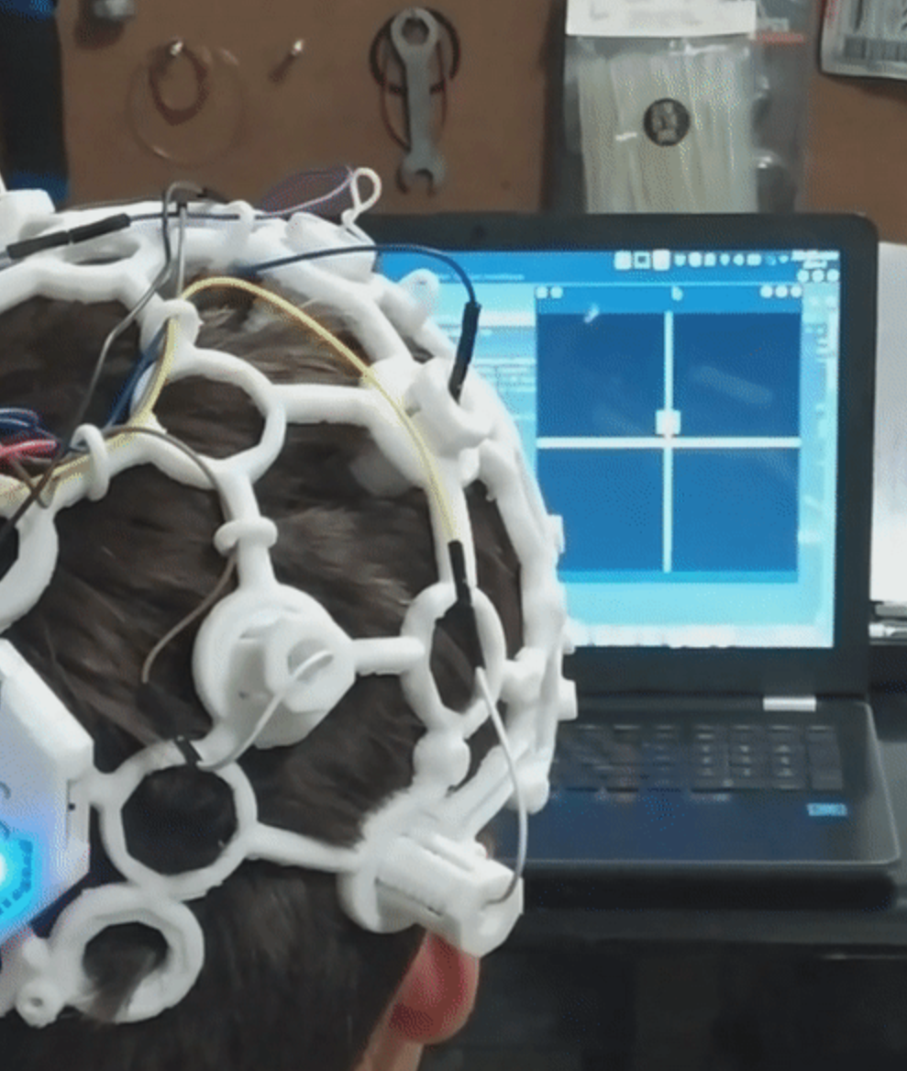
Previous Solutions
Citation: https://github.com/CrisSherban/BrainPad#readme
Notes:
Generally not a high degree of certainty even with just choosing between 2 instructions (all mental commands no movements)

Slide 11
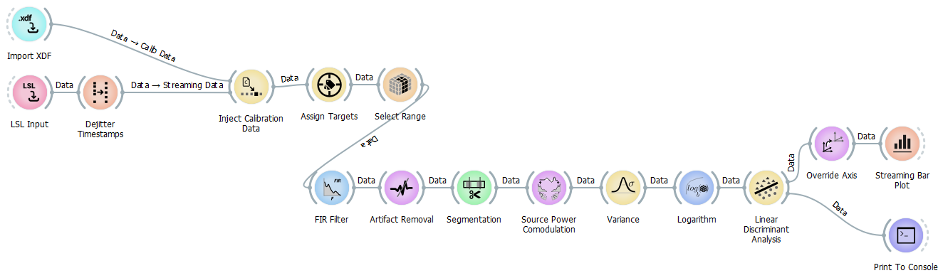
Accomplished Work
Notes:
(add image of histogram with possible actions)

Slide 12
Development Dynamics and Lessons Learned
Notes:
Problems with robustness of hardware, cant differentiate between certain signals that are similar: right/left, lots of noise more and better electrodes

Slide 13
What’s Left?

Slide 14
DEMO TIME

